Slide 1
Introduction to Conjoint-Analysis

Slide 2
Objective of Conjoint-Analysis
Measure and analyze the attitudes of stakeholders towards objects
Decompositionell approach (objects are considered jointly) -> the importance of the various attributes for the interviewees is determined by statistics
Compare with compound approach: Interviewees have to tell, how important the different attributes or properties of objects are in their opinion

Slide 3
Task
Let us assume that we want to find out, what kind of renewable energy power plants the inhabitants of our home town would prefer
In order to keep things simple: They may choose between different PV und Wind systems.

Slide 4
Step 1: Please define different objects. Here: different PV- and Wind-power-systems
Each object can be described by its properties:
The results are so called stimuli
Notes:
Properties:
Energy source: (1=wind (=indirect solar power); 2=direct solar power)
land consumption (1=low; 2=high);
carbon footprint (1=comp. low < 50g/kWh, 2=comp. High >= 50 g/kWh)
Noise (1=almost not audible; 2=audible)
All in all 2 x 2 x 2 x 2 = 16 stimuli (combinations of properties) might be possible (= complete design)
PV roof system
PV ground mounted system
Floating PV
Agri PV
Windpower plant

Slide 5
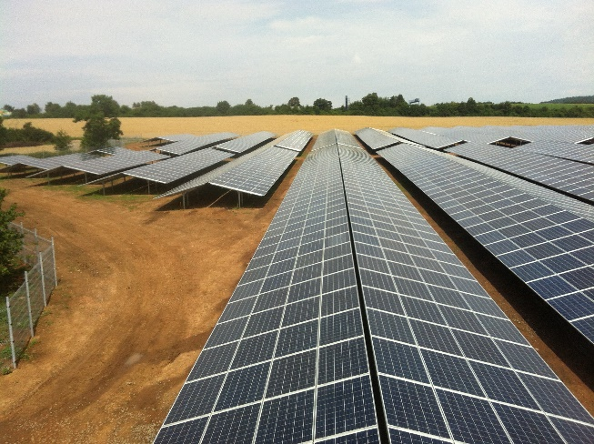
Example for a stimulus
Ground mounted PV plant energy source: 2 = direct solar power land consumption 1 = high carbon footprint 1 = low (about 33g/kWh) noise : 1 = almost not audible

Slide 6
Step 2: Interviewees have to be asked about their preferences
There are different approaches for this. For example, the subjects have to rank the stimuli or rate the stimuli
Notes:
Properties:
Energy source: (wind (=indirect solar power); direct solar power)
land consumption (low/little; high);
carbon footprint (comp. Low; comp. high)
Noise (almost not audible; audible)
All in all 2 x 3 x 2 x 2 = 24 stimuli (combinations of properties) might be possible (= complete design)
PV roof system
PV ground mounted system
Floating PV
Agri PV
Windpower plant

Slide 7
Example for rating a stimulus (Stimulus number x)
energy source: 2 = direct solar power land consumption 1 = high carbon footprint 1 = low (about 33g/kWh) noise : 1 = almost not audible
Construction and operation of onshore ground mounted PV power plants for our purpose …
1 I very strongly disagree |  | 2 |  | 3 |  | 4 |  | 5 |  | 6 I very strongly approve

